Slide 1
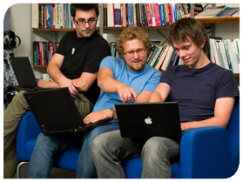





.
Qt in Education
An Introduction
to
Qt and MeeGo
Notes:
This lecture will introduce Qt and MeeGo, it is divided into the following sections:
- overview of MeeGo
- installing the Qt tools
- a typical workflow

Slide 2


© 2011 Nokia Corporation and its Subsidiary(-ies).
The enclosed Qt Materials are provided under the Creative Commons
Attribution-Share Alike 2.5 License Agreement.
The full license text is available here:
http://creativecommons.org/licenses/by-sa/2.5/legalcode.
Nokia, Qt and the Nokia and Qt logos are the registered trademarks
of Nokia Corporation in Finland and other countries worldwide.

Slide 3


Introduction
Notes:
During this lecture, we will talk about MeeGo and Qt, and how the two communities fit together.
We will also spend some time looking at what MeeGo actually is, and what sets it apart from the competition.

Slide 4



MeeGo
MeeGo is a Linux distribution
  Founded by Nokia and Intel
  Hosted by the Linux Foundation
Notes:
Basically, MeeGo is a Linux distribution, i.e. a collection of components (libraries, applications, scripts and configurations) that forms a GNU/Linux environment. It targets devices and mobile machines.
The history is that Nokia ran the maemo project – used for n7x0, n8x0 and the n900 devices.
At the same time, Intel ran the moblin project, building a Linux distribution for mobile devices.
In February 2010, the MeeGo project was announced, merging the two projects into one.
The entire project is hosted by the Linux Foundation

Slide 5
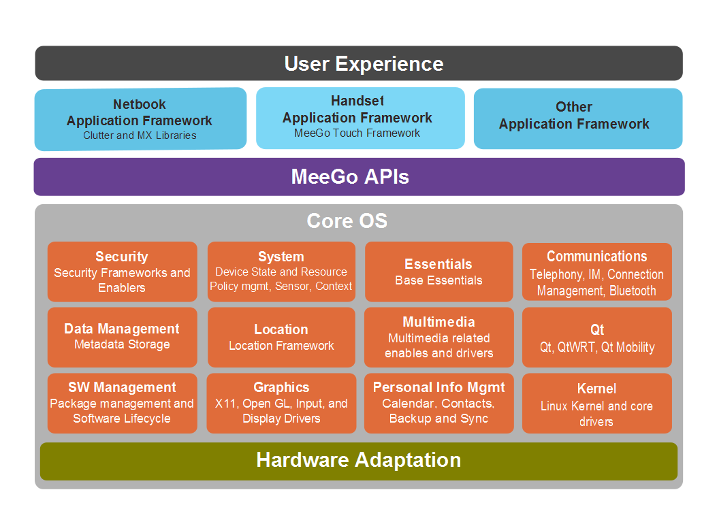
MeeGo
The architecture
a set of middleware components
a set of user experiences
Notes:
MeeGo is built from a set of layers. At the top level, there are a number of user experiences, UXes, defining the look and feel for a specific vertical.
Then, there is a set of APIs and components. For each functionality, MeeGo has chosen which software to use. For instance, Qt is the preferred way to build user interfaces.
Below the OS we find a set of hardware adaptations, i.e. kernels meeting both the requirements of the core OS, as well as a specific set of hardware.

Slide 6
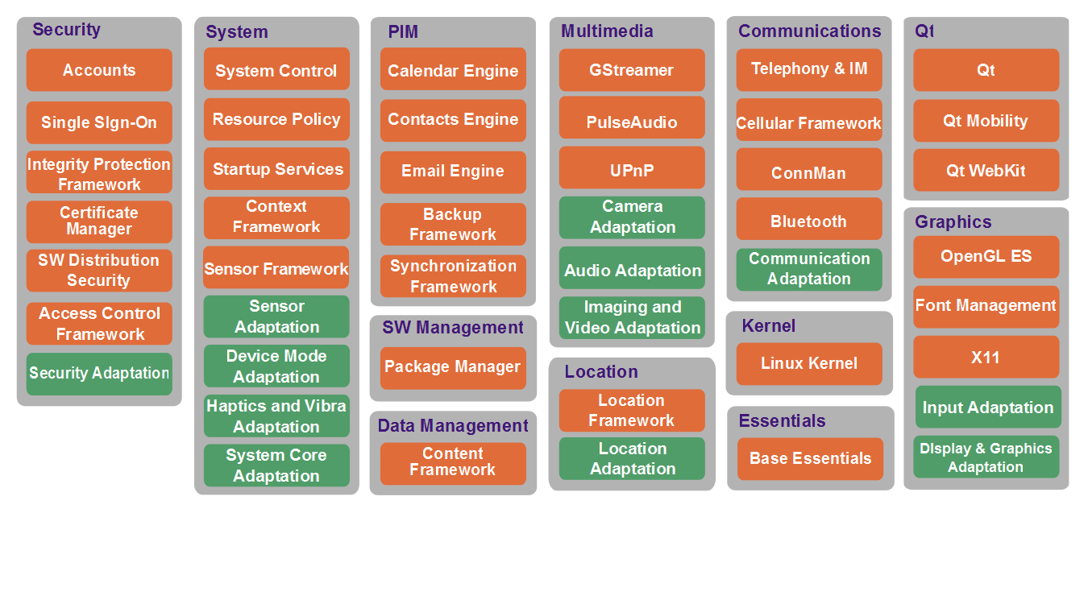
MeeGo
Notes:
Looking closer at the functions that MeeGo aims to deliver, we can see that the target is to cover all the needs of a mobile Linux-based device.
In this diagram, the green boxes indicate pieces of software that become more or less hardware dependent, while the orange boxes represent standard components. By interacting with the standard components, MeeGo applications become movable between devices.

Slide 7
User Experiences
The user interface used on top of the MeeGo core is commonly referred to as a User Experience – UX
  A UX is more than a user interface
  It defines not only the look of an application, but the entire interaction experience
    Integration of applications
    Common interface methods
    Integration with the physical device
    etc
Notes:
The user interface running on top of MeeGo is often custom, as MeeGo targets different devices.
The UI is commonly called User Experience, or UX.
The term UX, encompasses more than the term UI. It defines the entire interactive experience, and not only the graphical interface of a single application.
It can include the integration of multiple applications (deep linking seems to be the term of the day), common methods to structure data in the user interface and common ways to interact with these structures. It can also include integration with the actual physical machine, e.g. physical buttons and sensors.
Continues

Slide 8






Available UXes
Netbook
Tablet
Handset
In-vehicle Infotainment
Smart TV
Media Phone
Notes:
To the user, MeeGo will be familiar through a set of user experiences, UXes. Currently, there are six UXes: netbook, tablets, handset, in-vehicle infotainment, smart TV and media phone.
Each of these UXes are designed to work on a different type of device – so each device have slightly different properties when it comes to screen-size, input methods, etc.

Slide 9
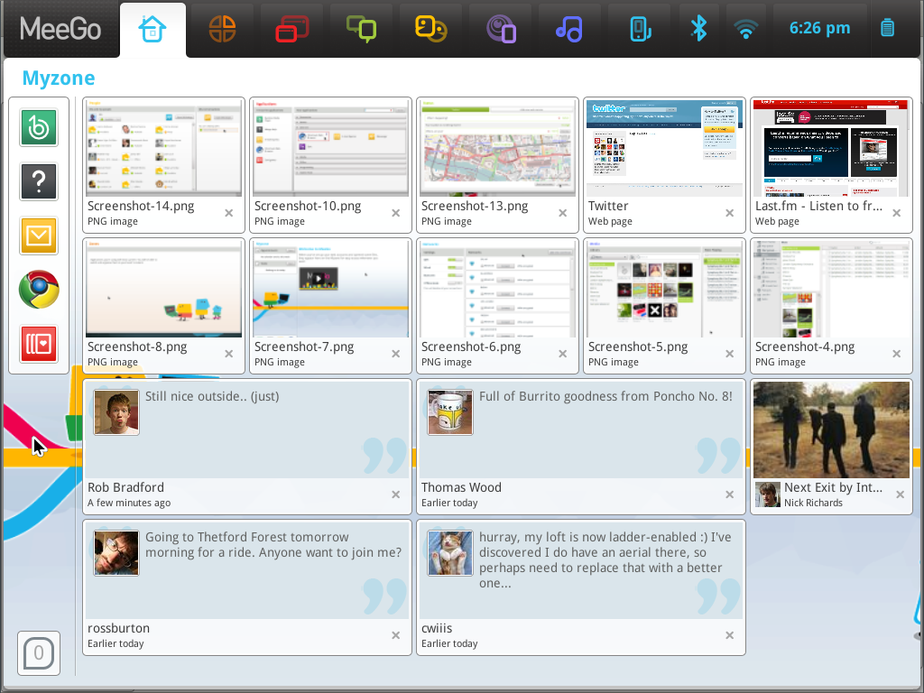
UX: Netbook
Windows are
maximized or
full screen
Devices have
keyboards
Devices have
pointer devices
Devices might have touch screens
Notes:
The netbook UX targets portable computers with smaller screens. They generally have keyboards, and possibly touch

Slide 10
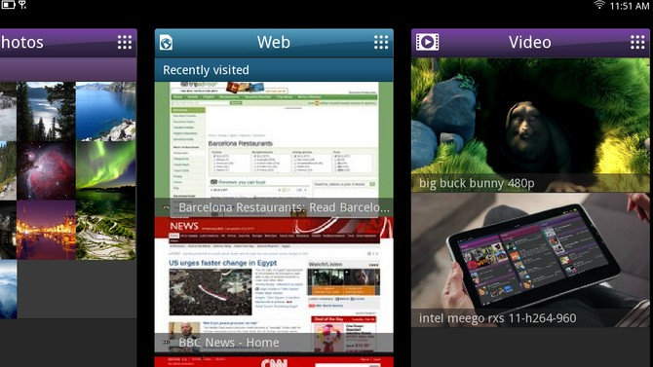
UX: Tablet
Windows are
maximized or
full screen
The screen
orientation can
change
Devices might not have keyboards
Devices have (multipoint) touch screens
Notes:
Tablets, or slates, are portable touch screen devices.
They are targeted at multi media consumption, reading and web browsing, so the screens are generally of high resolution.
Input is usually limited to a (multipoint) touch screen.

Slide 11
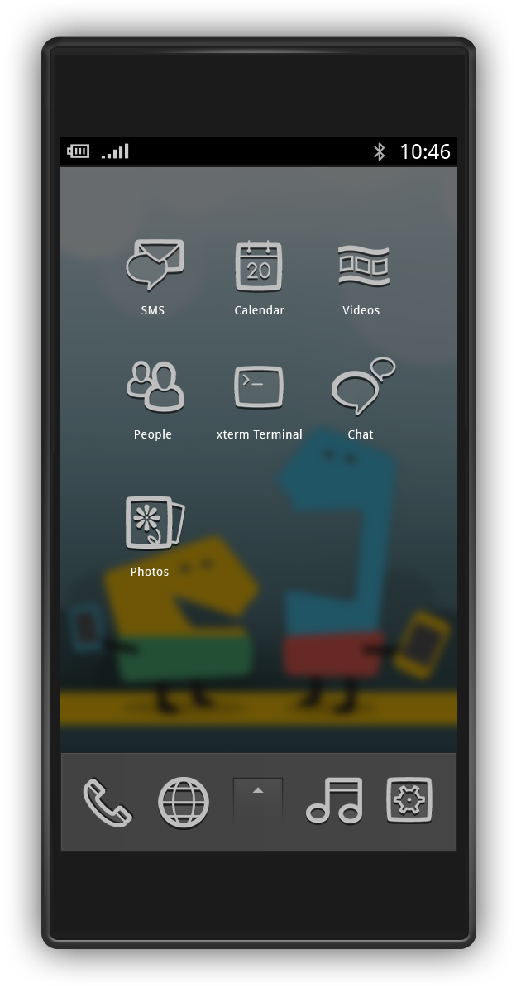
UX: Handset
Windows are maximized
or full screen
The screen orientation
can change
Devices are likely not to
have keyboards, or to
have limited keyboards
Devices have touch
screens
Notes:
The handset user experience is targeted at handsets, i.e. mobile phones / cell phones. They are likely to not have a keyboard, or a very limited keyboard. They are also likely to have touch screens, even multipoint touch screens.
One difference to the netbook UX, is that the handset screen orientation can change as the user turns the device around.

Slide 12
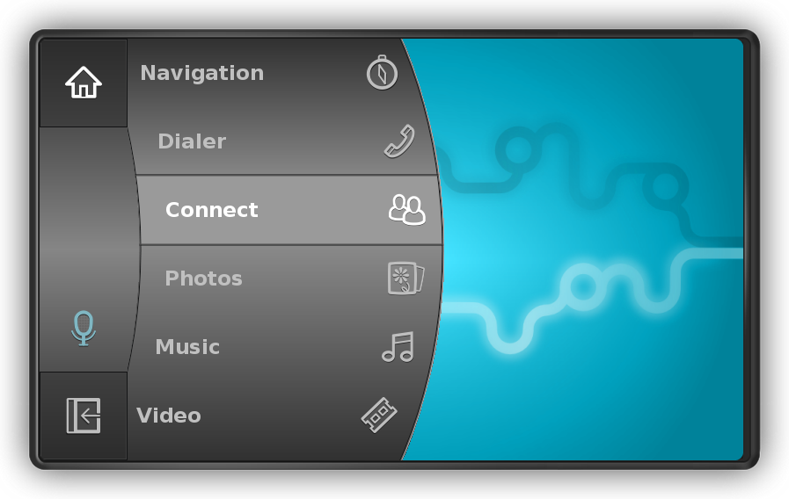
UX: In-Vehicle Infotainment
Windows are
maximized or full
screen
Interaction can be
limited to a very
limited set of
buttons
Notes:
The In-Vehicle Infotainment (commonly abbreviated as IVI) user experience usually focus on information and multimedia. This means a relatively large screen, but very limited input.
The devices might have touch, but probably not a keyboard. Voice interaction is being used, but is hard to use in all settings.

Slide 13
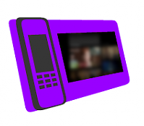
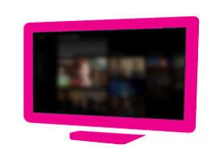
UX: Smart TV / Media Phone
The Smart TV and Media Phone UXes are work in progress
Targets media streaming, video conferencing, entertainment, etc
Notes:
The smart TV and Media Phone user experiences are work in progress. They will target streaming, video conferencing, entertainment and general multimedia tasks.
For a TV, the screen is likely to be of much higher resolution than for all other user experiences, but at the same time the user is likely to be further away from the screen, so the graphics need to be large.

Slide 14
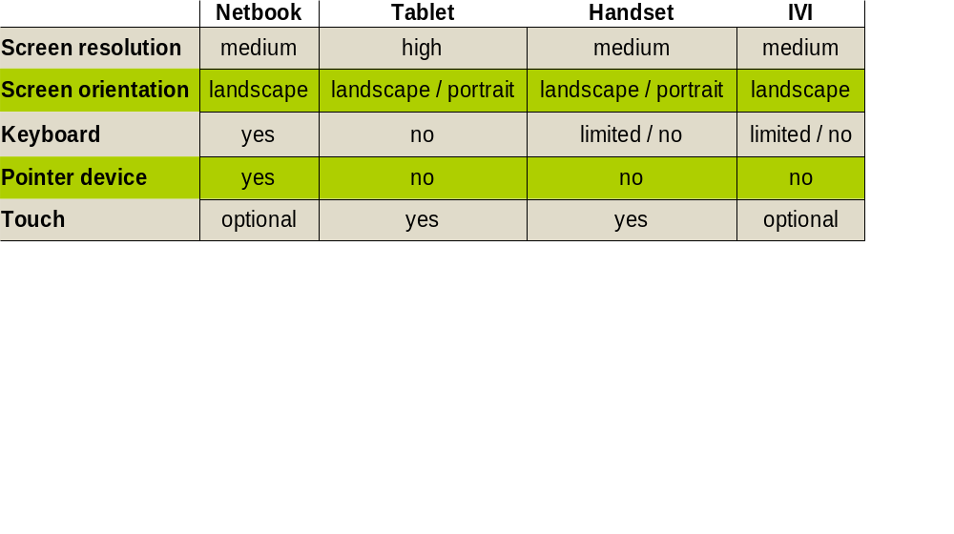
UX Comparison Chart
Notes:
This comparison chart tries to capture the major differences between the user experiences currently defined.
The characteristics here tries to define the average devices, so do not take anything for granted. For instance, there are netbooks with high resolution screens as handsets with full keyboards.

Slide 15
Why MeeGo
Users
  The same application across multiple verticals
  Modern user experience
OEMs
  Time to market
  Based on a stable, shared ground
Developers
  One target environment for multiple markets
  Great development tools
Notes:
Why does one choose to go with MeeGo? The answer depends on who you are.
For an end user, the possibility to use the same apps across multiple devices can be tempting. Imagine using the same twitter client across your phone, car and TV.
The goal of MeeGo is also to provide a modern, slick user experience
For OEMs (Original Equipment Manufacturers) the time to market is an important factor. MeeGo provides a base to stand on. It is also important that the base is established as a proven and stable
For developers (you) you can use the same environment and development tools to reach multiple markets. The goal of MeeGo is also to provide great development tools.

Slide 16
Finding MeeGo
Maemo is a predecessor to MeeGo
  Used on N7x0, N8x0 and N900 devices
  Supported by Qt
MeeGo for netbooks
  Runs on Intel-based netbooks
MeeGo for handsets
  Runs on N900 and Aava handsets
Notes:
Where can you find MeeGo today?
The predecessor, Maemo, is found on a range of internet tablets and a handset from Nokia. All these support development in Qt, so they can be considered source code compatible with MeeGo.
The netbook user experience can be run of most Intel-based netbooks.
The handset user experience can, already today, be run on the N900 handset (Arm based), as well as the Aava handset (Intel based).

Slide 17
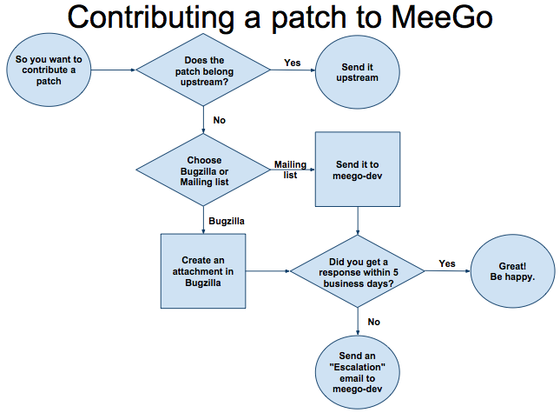
How MeeGo Works
MeeGo wants to
integrate well with
the open source
community
All patches that can be
submitted up-stream are
required to be submitted there
In an ideal world, MeeGo would not depend on any patches
Notes:
When working with MeeGo it is important to realize how it is different from other Linux distributions.
MeeGo aims to integrate well with the open source communities which results it is based on.
This means that all patches that can be applied up-stream, should be submitted there before they are accepted by MeeGo.
In the end, this should lead to a situation where MeeGo is completely free from patches.

Slide 18
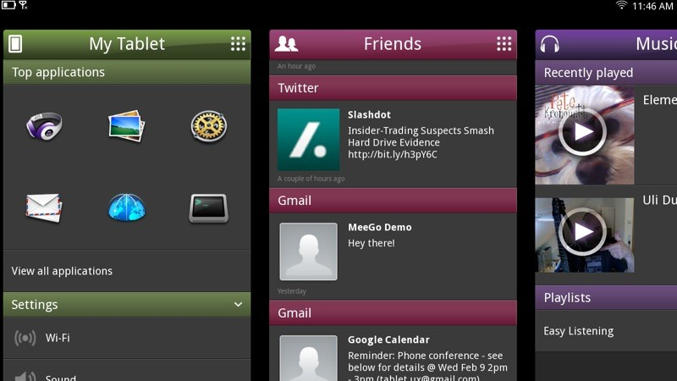
Qt and MeeGo
Qt is the preferred way of building user interfaces across all MeeGo UXes
Qt Quick is
used
extensively
for tablets
The MeeGo SDK builds on Qt Creator
Notes:
How does Qt fit into MeeGo?
Qt is the preferred way of building user interfaces for all MeeGo UXes. Technologies such as Qt Quick and Qt Mobility makes it possible to move source code freely between devices and UXes.
In the tablet UX (currently under development) Qt Quick is actually used as the foundation of almost all user interface graphics.
In addition to this, the MeeGo SDK is built on Qt Creato, so the Qt tooling is used.

Slide 19

Break

Slide 20
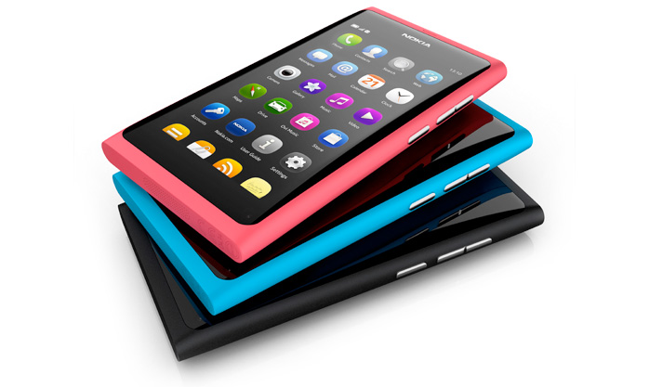
Example Hardware
Nokia N9
  Arm-based
  Multi-point touch
  Slide-out keyboard
Notes:
The Nokia N9 ships with MeeGo. It is the first MeeGo powered handset.
The N9 is arm-based, provides a capacitive multi-point touch screen and a sliding keyboard.
It also provides a range of sensors (orientation, gps, camera)
A technical note is that the N9 is running a MeeGo compatible version of Maemo. This means that the package format is deb (not rpm). (more about this in the next MeeGo lecture)

Slide 21
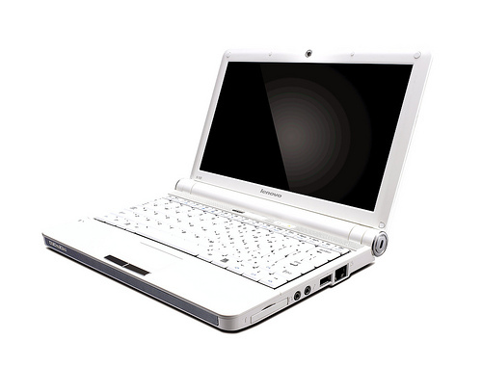
Example Hardware
Intel based Netbook
  Intel Atom or Intel Core 2 CPU
  (requires support for SSSE3)
  Not GMA-500, Nvidia, or ATI
Notes:
Intel based Netbooks with CPUs supporting SSSE3, and without the GMA500, Nvidia or ATI graphics is supported out of the box.
These devices generally provide a full keyboard and a pointing device. Some devices provide a full multipoint touch screen.
The meego.com web site contains a list of tested netbook that are known to work.

Slide 22
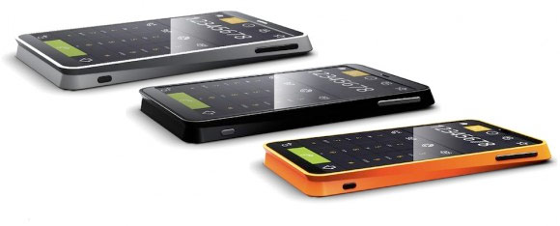
Example Hardware
Aava Handset
  Intel Atom CPU
  Multi-touch
Notes:
The MeeGo handset UX can be run on the Aava handset as well. The Aava handset is based on an Intel Atom CPU and provides a multipoint touch screen.

Slide 23


Example Hardware
BeagleBoard
  TI OMAP3
PandaBoard
  TI OMAP4
Arm-based evaluation boards with multimedia focus
Notes:
Another popular target is the BeagleBoard and the PandaBoard. These boards are based on the OMAP Arm SoC (system-on-a-chip) from Texas Instruments.
They are evaluation boards, so keyboard, screen and pointing devices must be provided by the user.

Slide 24
Developing for MeeGo
The MeeGo SDK contains most components
  Uses MADDE for building
  (MeeGo Application Development and Debug Environment)
  QtSimulator for quick development
  Remote debugger for hardware target development
Virtual machine for target development
  VirtualBox
Notes:
To develop with MeeGo, the MeeGo SDK is used.
It relies on MADDE (MeeGo Application Development and Debug Environment) and Qt Simulator.
Qt Simulator is a way to simulate a device, but executing the application natively on the development machine.
MADDE contains tool-chains for other targets, as well as support for virtual targets. It is also possible to debug an actual target remotely from within the MeeGo SDK.
For a remote target we will use a VirtualBox machine running MeeGo.

Slide 25
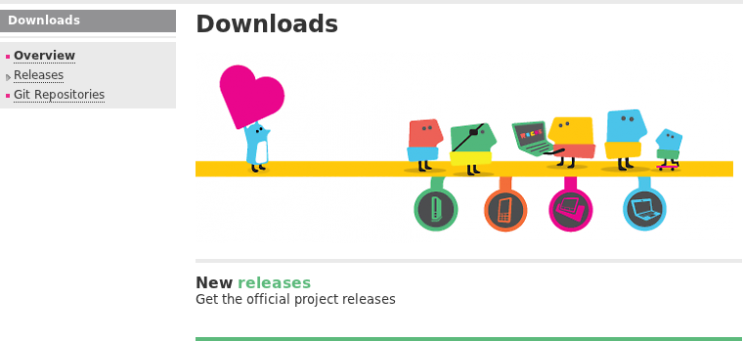
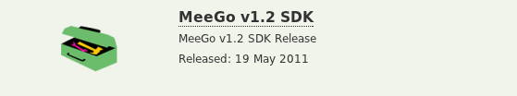
Downloading MeeGo SDK
From http://meego.com/downloads
Follow the links
through the pages
until you locate the
installer binary
Download the binary
Notes:
The MeeGo SDK is linked to from the meego.com/downloads site.
Locate the MeeGo SDK link there, and follow it. You might have to click through two-three pages to find the actual download.
Download the binary
Continues

Slide 26
Running the Installer
The installer is 26MB, but downloads GBs of data during Install
  Make sure to have a good Internet connection while installing
The installer must be made executable before running, e.g.
  chmod +x meego-sdk-installer-online-*
  ./meego-sdk-installer-online-*
Notes:
The installer binary is ~26MB, but it is an “online installer”. This means that it will download the environment during the install procedure. This can be a multi-gigabyte download, so make sure that you are using a good Internet connection during the install process.
When installer has been downloaded, it cannot be executed. The executable flag must be set on the file. You can do this using the chmod command. Then run the installer.
Continues

Slide 27
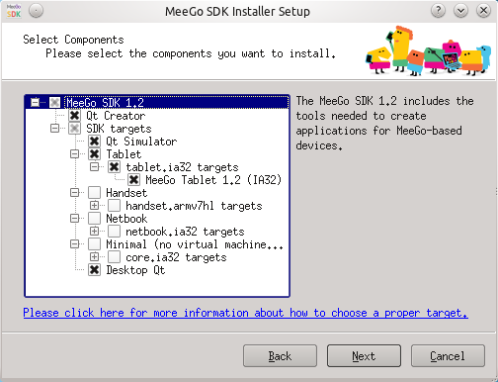
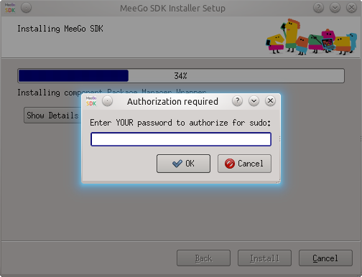
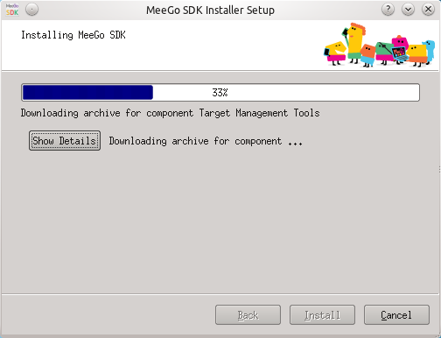
Running the Installer
Simulator and Tablet
Enter sudo credentials
Enjoy the installation
Notes:
When running the installer, make sure to select the simulator and tablet targets. The sudo credentials will be requested for the current user, then the installation proceeds.
As the installation downloads large amounts of data, and installs up to 10GB of files, the installation can take a long time. Plan for this.
Continues

Slide 28
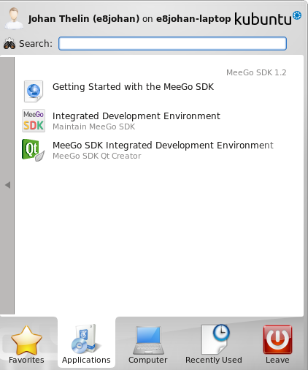
What was Installed?
Development Environment
MADDE targets
$ mad-admin list
Targets:
meego-core-ia32-1.1 (installable)
meego-core-ia32-1.1.2 (installable)
meego-core-ia32-trunk (installable)
meego-handset-ia32-1.1.2 (installable)
meego-handset-ia32-1.1.2-4.7.1 (installable)
meego-handset-ia32-1.1 (installable)
meego-handset-ia32-w32-1.1 (installable)
meego-handset-ia32-trunk (installable)
meego-netbook-ia32-1.1.2 (installable)
meego-netbook-ia32-1.1.2-4.7.1 (installable)
meego-netbook-ia32-1.1 (installable)
meego-netbook-ia32-w32-1.1 (installable)
meego-netbook-ia32-trunk (installable)
meego-tablet-ia32-1.2.0.90.0.20110517.1 (installed)
Runtimes:
meego-handset-ia32-qemu-1.1.20110110.1026-runtime (installable)
meego-handset-ia32-qemu-1.1.20110118.1010-runtime (installable)
meego-handset-ia32-qemu-1.1.20101031.2201-sda-runtime (installable)
meego-handset-ia32-w32-qemu-1.1.20101031.2201-sda-runtime (installable)
meego-handset-ia32-qemu-1.1.99.0.20110329.5-runtime (installable)
meego-netbook-ia32-qemu-1.1.20110110.1049-runtime (installable)
meego-netbook-ia32-qemu-1.1.20110118.1020-runtime (installable)
meego-netbook-ia32-qemu-1.1.20101031.2037-sda-runtime (installable)
meego-netbook-ia32-w32-qemu-1.1.20101031.2037-sda-runtime (installable)
meego-netbook-ia32-qemu-1.1.99.0.20110329.5-runtime (installable)
meego-tablet-ia32-qemu-1.2.0.90.0.20110517.1-runtime (installed)
Notes:
The installer installs two major components:
- The development environment, which is a pre-configured version of Qt Creator
- MADDE targets, in the example here, the Tablet UX
Continues

Slide 29
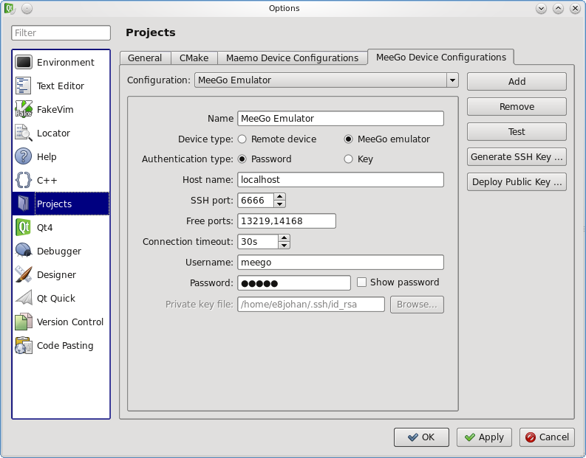
Targets
MADDE works with targets
  A pre-configured build environment consisting of tool-chain and libraries
    meego-core-armv7l
    meego-netbook-ia32
    etc
Targets are added as Qt
Versions in Qt Creator
Simply pick the right
target when building
Notes:
The MADDE targets are pre-configured installs of a build environment or a virtual target machine.
They are named meego-<ux>-<architecture>. For example core for arm, or netbook for intel (ia32).
The targets are added to Qt as Qt versions and project targets in Qt Creator. The SDK is pre-configured, so you can find the targets in the options dialog.
When building, you can simply pick the right target from the menu just over the build and run buttons.

Slide 30
Typical Development
Work-flow of a project
  Setup a project
  Develop using simulator
  Switch to target and build an RPM
  Deploy to virtual target or remote target
  Perform final testing and polish
Notes:
Let's look at the typical work flow for a MeeGo project
- You start by setting up a project
- You do most of your development using the simulator
- When the simulator target runs fine, or you have target specific tests (performance, service availability, etc), switch build target and build an RPM
- Deploy the RPM to a target and run it there
Qt Creator supports both virtual and actual targets. It is also possible to do remote debugging on both virtual and actual targets.
Continues

Slide 31
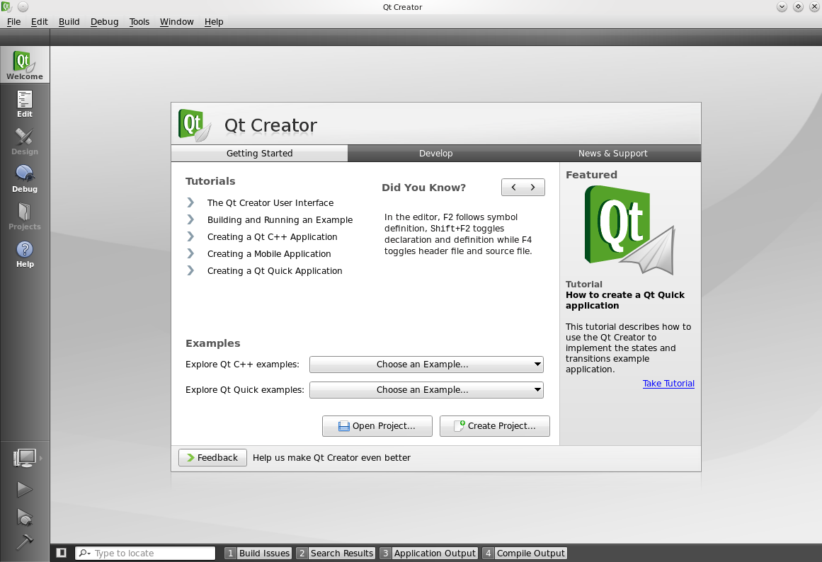
Qt Creator
Notes:
When starting Qt Creator, you can open existing projects and examples, as well as creating new projects.
Continues

Slide 32
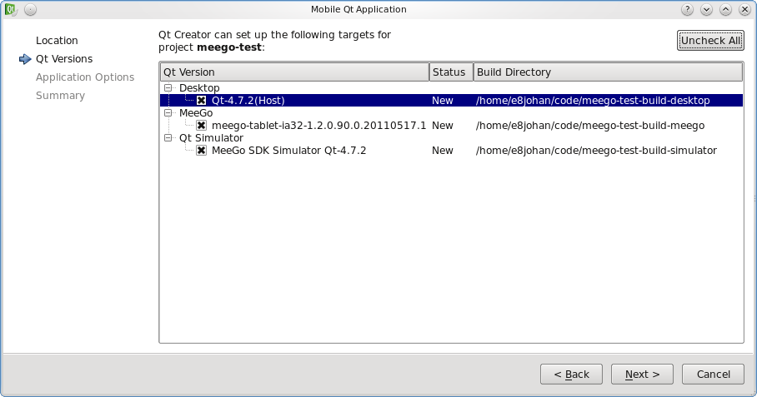
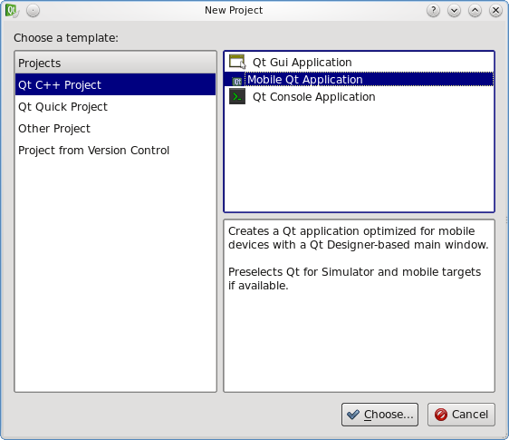
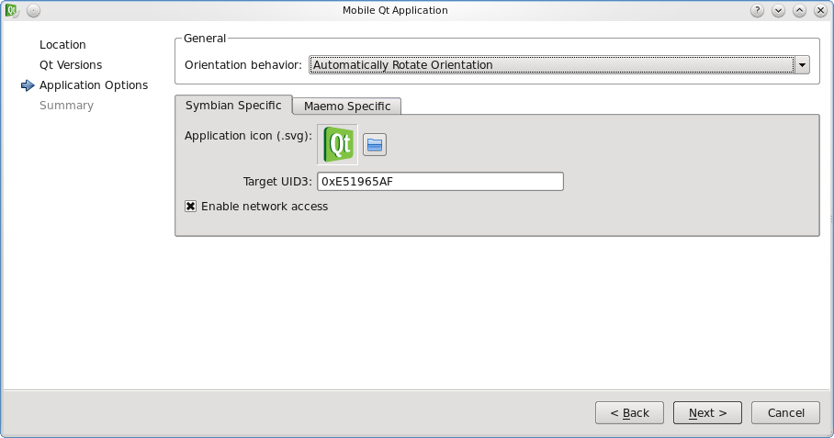
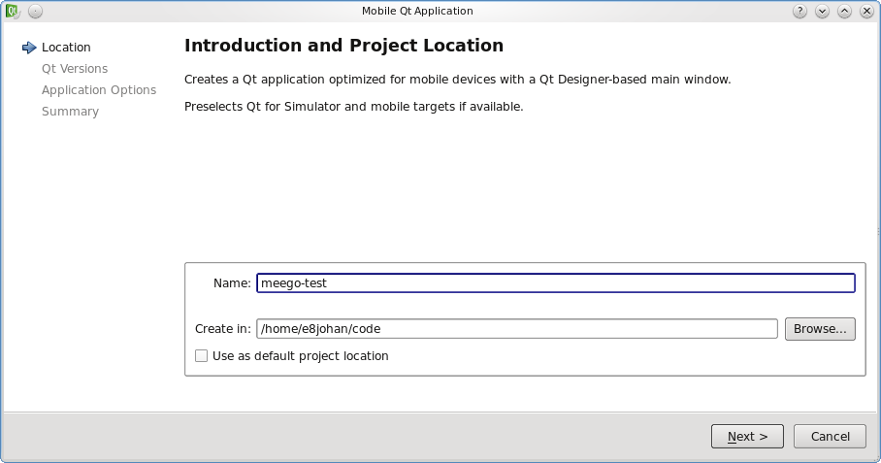
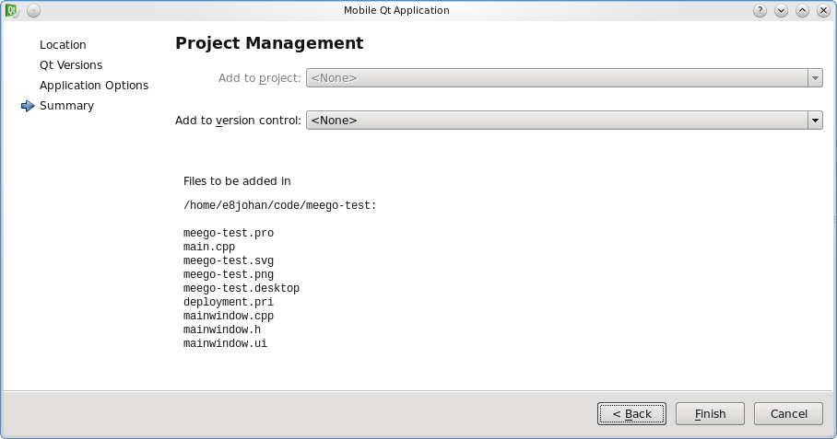
Create a Project
Notes:
(image order, top-left, down, then top-right, down)
Creating a new project.
1. Select type of project. In this case, C++, for mobile
2. Select a location for the project.
If you place files in /foo/bar and call it test, the sources will live in /foo/bar/test and builds in /foo/bar/test-build-<target>
3. Configure targets – simulator, meego and optionally desktop
4. Target specifics, icons and such, nothing that we will touch today
5. Summary, a list of the generated files and an option to use a version control system
Continues

Slide 33
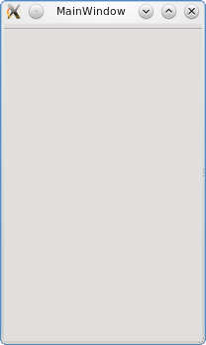
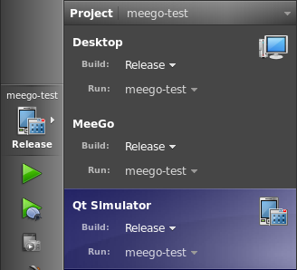
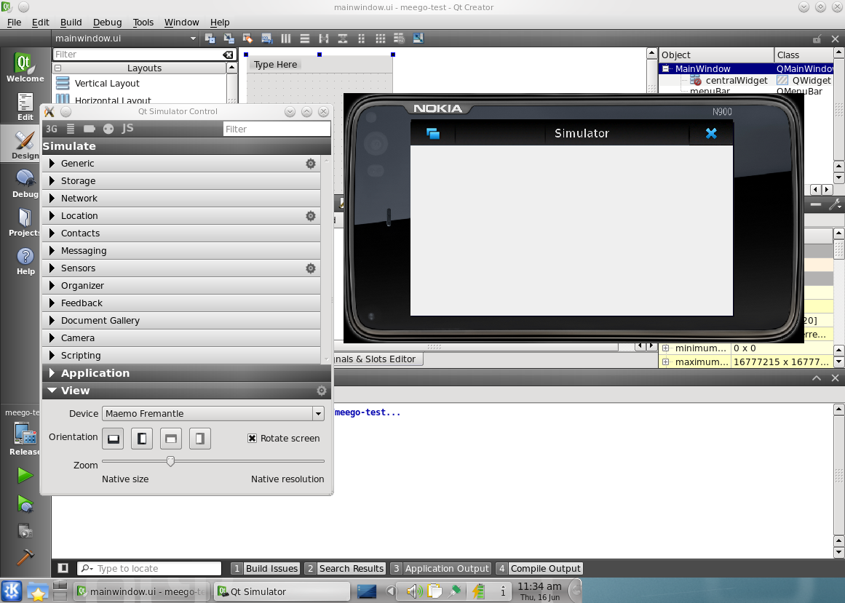

Targets
Switching targets is just a matter of selecting it from from a menu
Notes:
The target menu now lets you choose between desktop, simulator or MeeGo (i.e. target)
When building for MeeGo, given the project name test located at /foo/bar, the RPM ends up at /foo/bar/test-meego-build/rrpmbuild

